Slide 1

IBM SkillsBuild for Adult Learners - Data Analytics
Data Analytics Internship Program 2024 Final Project Presentation
Project Name : Multiple Disease Prediction
Unique ID : IBM1652 Team Name : Code breakers
College Name : Guru Jambeshwar University Of Science and Technology,
Hisar

Slide 2





Team Members
Maneesha
Nishant
Punit verma
Sahil
Seema

Slide 3
Introduction
Chronic diseases such as heart disease, diabetes, and kidney disease are major causes of mortality and morbidity globally.
Early detection and proactive management are crucial for mitigating the adverse health outcomes associated with these diseases. However, the complexity and variety of risk factors, coupled with the need for comprehensive and personalized care, make early diagnosis difficult.

Slide 4
Objective
The primary objective of this project is to Utilize machine learning algorithms to create a model that can predict the risk of multiple chronic diseases, including heart disease, diabetes, and kidney disease and. The specific objectives are:
To collect and analyze data of various chronic diseases from various sources.
To develop a predictive model for multiple diseases using Python-based data analytics.
To integrate various datasets for comprehensive analysis and prediction.
To evaluate and validate the predictive model's performance and accuracy.
To provide actionable insights for healthcare professionals to improve patient outcomes
To contribute SDG 3

Slide 5
Problem Statement
The early detection of chronic diseases remains a significant challenge. Traditional diagnostic methods are often reactive, detecting diseases only after symptoms appear. This delay can lead to more severe health complications, increased healthcare costs, and higher mortality rates. To address this issue, there is a need for a robust predictive model that can accurately assess the risk of multiple chronic diseases based on a combination of health metrics and lifestyle factors.

Slide 6
Relevant SDGs
The United Nations Sustainable Development Goal 3 (SDG 3) aims to ensure healthy lives and promote well-being for all at all ages.
Multiple Disease Prediction Contributes:
Early Detection: ML models can predict the risk of chronic diseases like heart disease, diabetes, and kidney disease, facilitating early diagnosis and timely intervention.
Prevention: Identifying risk factors through predictive modeling can inform preventive strategies and lifestyle modifications to reduce disease incidence.
Personalized Medicine: Predictive models enable personalized treatment plans tailored to individual risk profiles, improving patient outcomes.
Healthcare Efficiency: Early detection and management reduce the burden on healthcare systems, lowering costs and improving resource allocation.

Slide 7
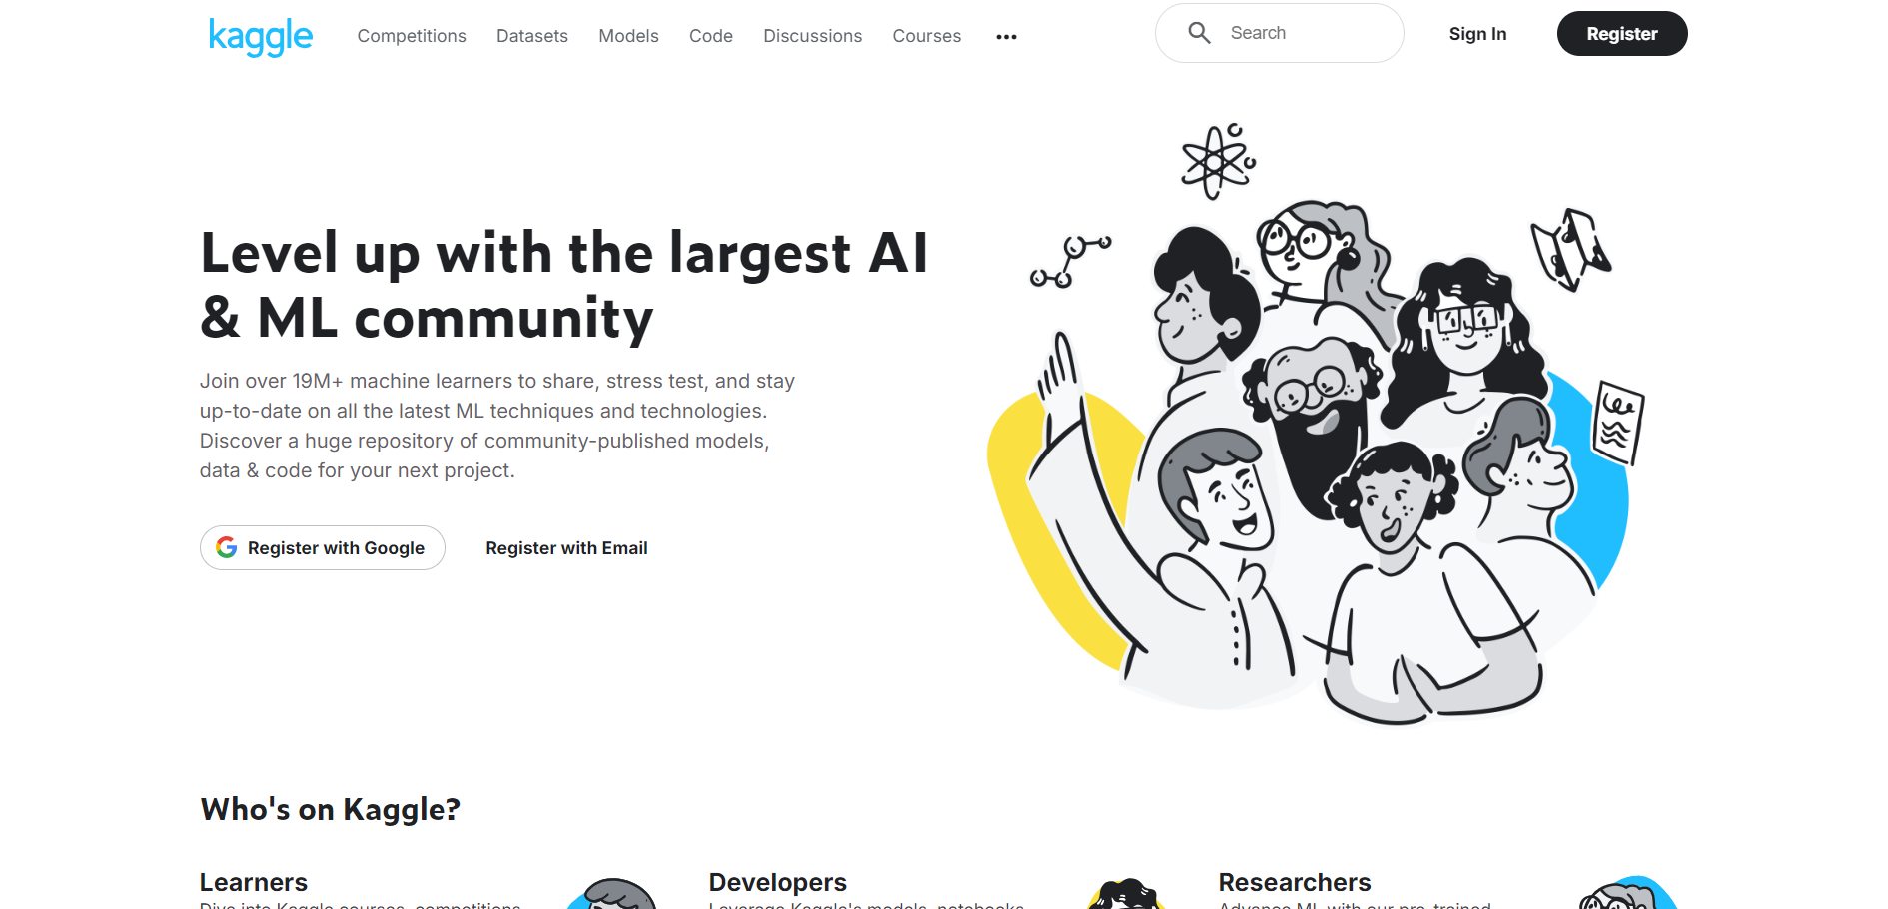
Data Collection
The dataset used in this project is taken from Kaggle. There are several attributes in the data set on which we are predicting, analyzing, visualizing of Multiple Chronic Disease
kaggle

Slide 8


SOURCES OF DATA USED
Disease 1: Alzheimer
This dataset contains extensive health information for 2,149 patients and offers extensive insights into the factors associated with Alzheimer's Disease, including demographic, lifestyle, medical, cognitive, and functional variables. It is ideal for developing predictive models, conducting statistical analyses, and exploring the complex interplay of factors contributing to Alzheimer's Disease
Link: https://www.kaggle.com/datasets/rabieelkharoua/alzheimers-disease-dataset
Disease 2: Asthma
This dataset contains extensive health information for 2,392 patients diagnosed with Asthma Disease and offers extensive insights into the factors associated with Asthma Disease, including demographic, lifestyle, environmental, allergy, medical, clinical, and symptom variables. It is ideal for developing predictive models, conducting statistical analyses, and exploring the complex interplay of factors contributing to Asthma Disease.
Link: https://www.kaggle.com/datasets/rabieelkharoua/asthma-disease-dataset

Slide 9
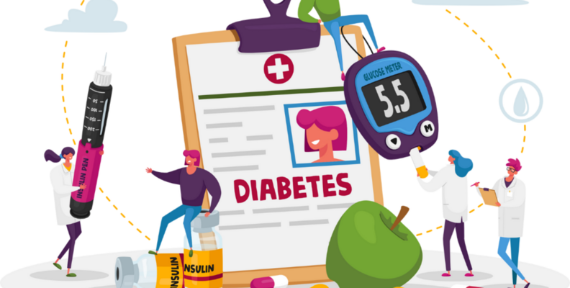

Disease 3: Diabetes
this dataset provides a rich landscape for in-depth analysis and exploration. Investigate patterns, correlations, and predictive models to enhance our understanding of diabetes risk factors, disease progression, and treatment outcomes
Link: https://www.kaggle.com/datasets/zain280/diabeties-dataset
Disease 4: Heart
This dataset consists of 1190 instances. This heart disease dataset is curated by combining 5 popular heart disease datasets already available independently but not combined before. In this dataset, 5 heart datasets are combined over 11 common features which makes it the largest heart disease dataset available so far for research purposes
Link: https://www.kaggle.com/datasets/mexwell/heart-disease-dataset

Slide 10


Disease 5: Chronic Kidney
This dataset contains detailed health information for 1,659 patients diagnosed with Chronic Kidney Disease (CKD). The dataset includes demographic details, lifestyle factors, medical history, clinical measurements, medication usage, symptoms, quality of life scores, environmental exposures, and health behaviors
Link: https://www.kaggle.com/datasets/rabieelkharoua/chronic-kidney-disease-dataset-analysis
Disease 6: Liver
This dataset has been preprocessed and cleaned to ensure that users can focus on the most critical aspects of their analysis. The preprocessing steps were designed to eliminate noise and irrelevant information, allowing you to concentrate on developing and fine-tuning your predictive models.
Link: https://www.kaggle.com/datasets/rabieelkharoua/predict-liver-disease-1700-records-dataset

Slide 11
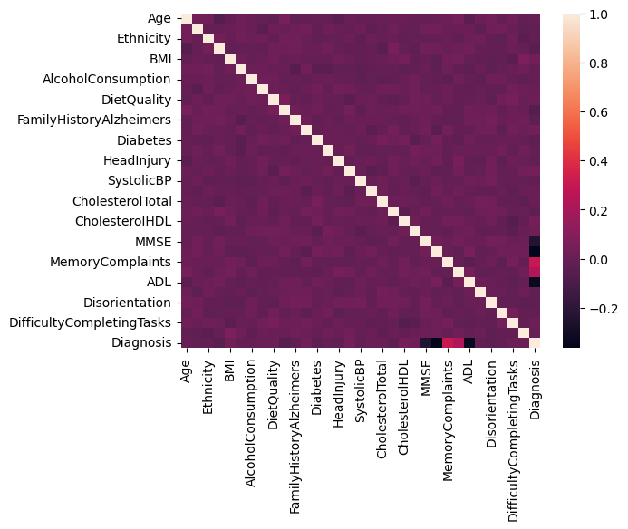
Data Analysis and Visualization
Exploratory Data Analysis (EDA) from data sets which we have used
Alzheimer

Slide 12
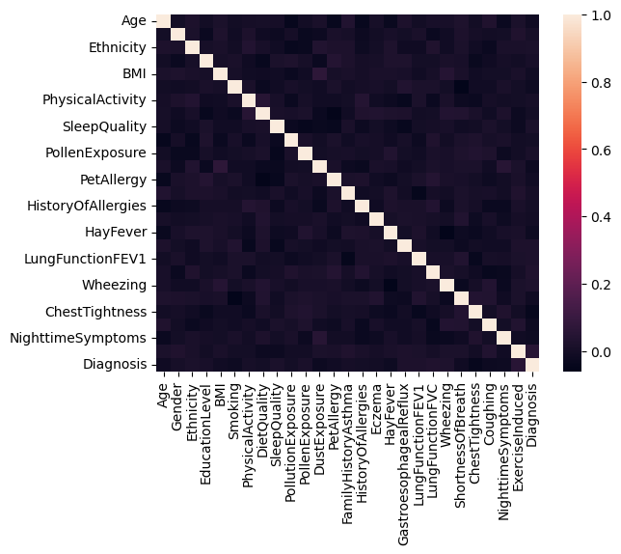
Asthma

Slide 13
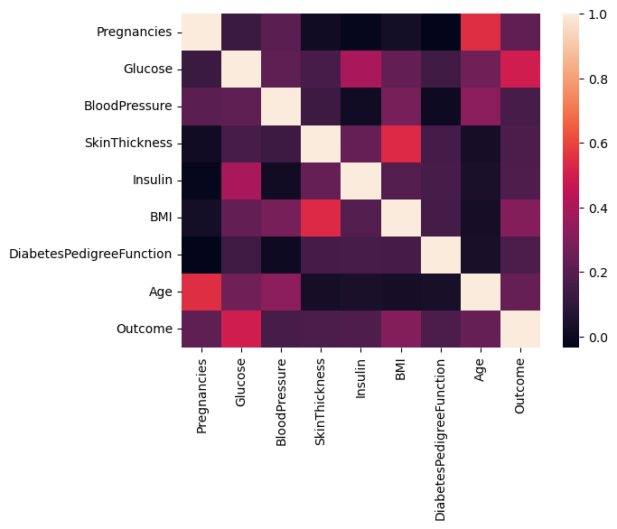
Diabetes

Slide 14
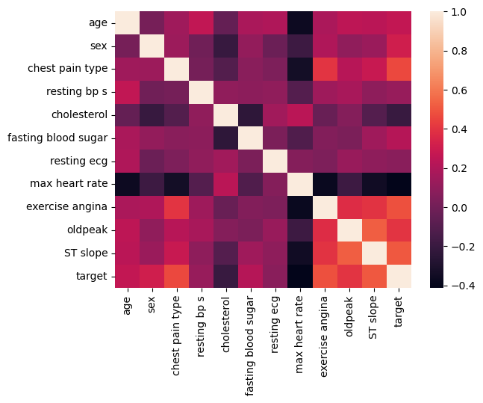
Heart

Slide 15
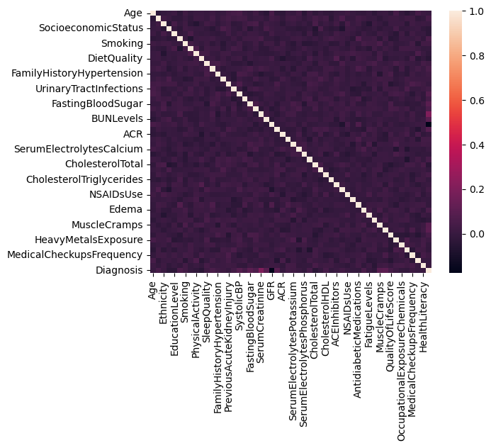
Chronic Kidney

Slide 16
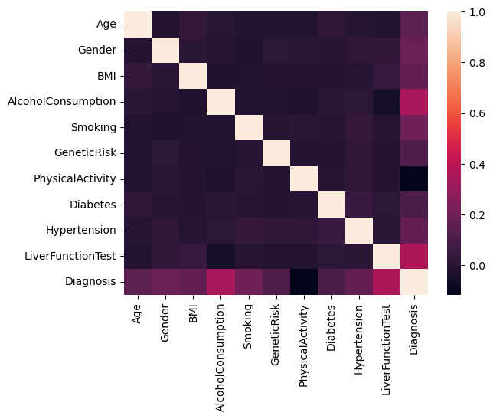
Liver

Slide 17
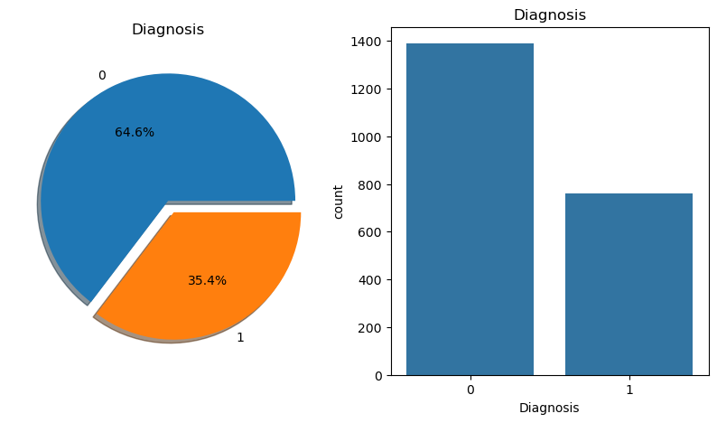
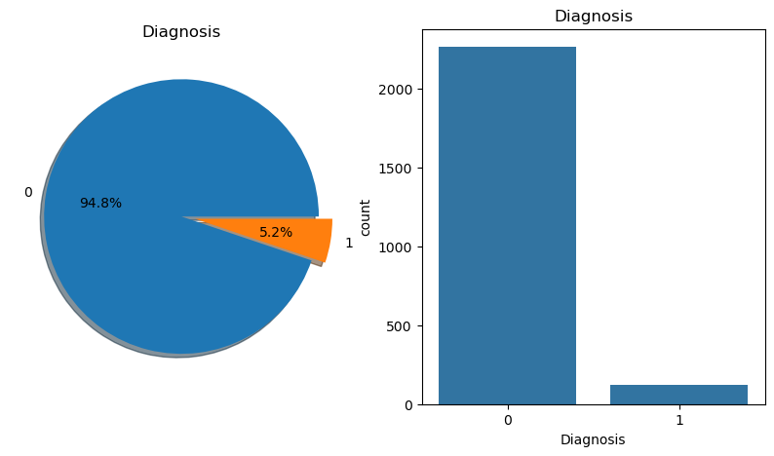
Positive(1) v/s Negative(0)
Alzheimer
Asthma
Negative (0): 1389
Positive (1): 760
Negative (0): 2268
Positive (1): 124

Slide 18
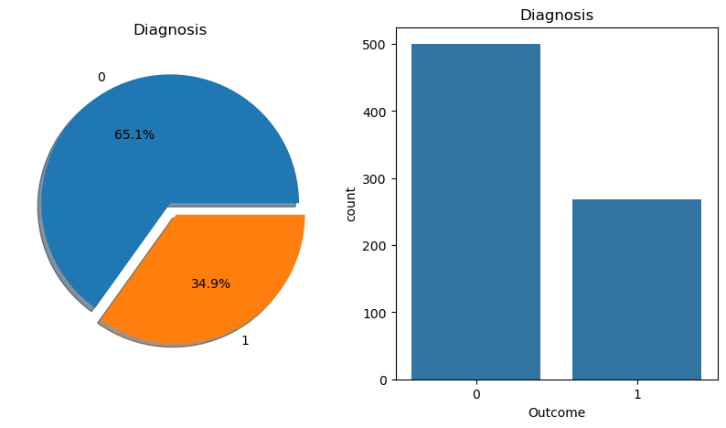
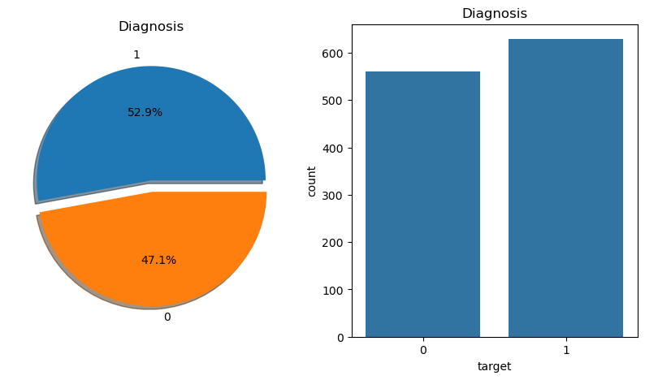
Positive(1) v/s Negative(0)
Diabetes
Heart
Negative (0):500
Positive (1): 268
Negative (0): 629
Positive (1): 561

Slide 19
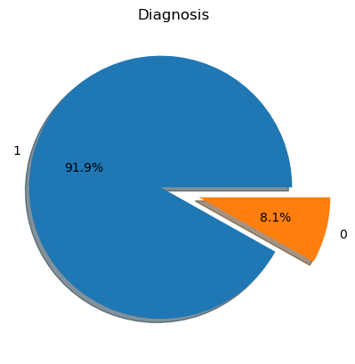
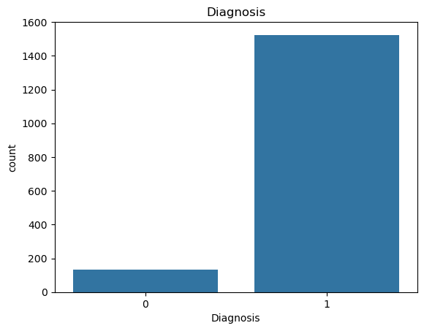
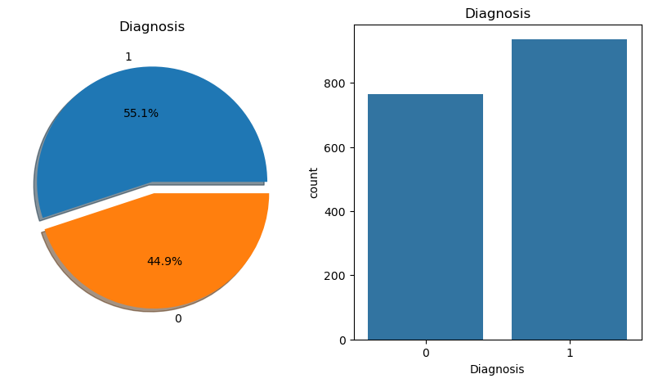
Positive(1) v/s Negative(0)
Chronic Kidney
Liver
Negative (0): 1524
Positive (1): 135
Negative (0): 936
Positive (1): 764

Slide 20
Accuracy
Alzheimer
Asthma

Slide 21
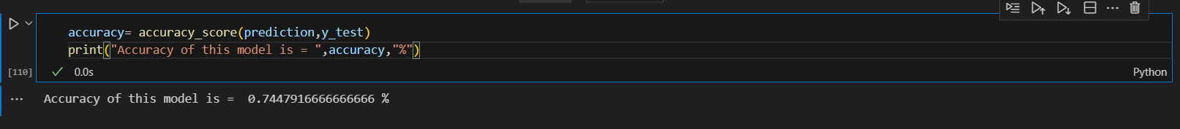
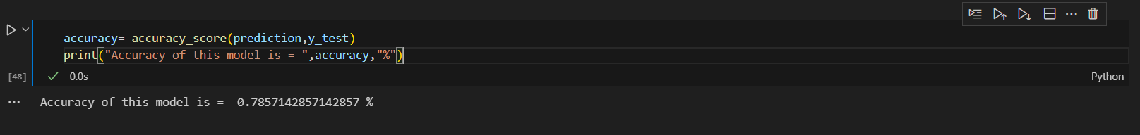
Accuracy
Diabetes
Heart

Slide 22
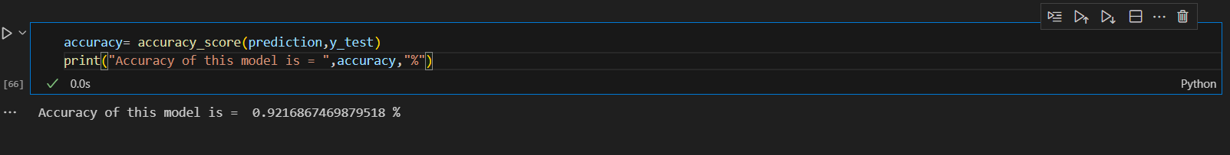
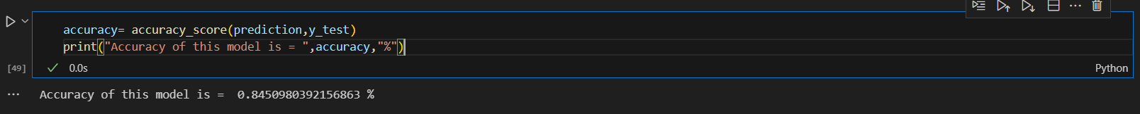
Accuracy
Chronic Kidney
Liver

Slide 23
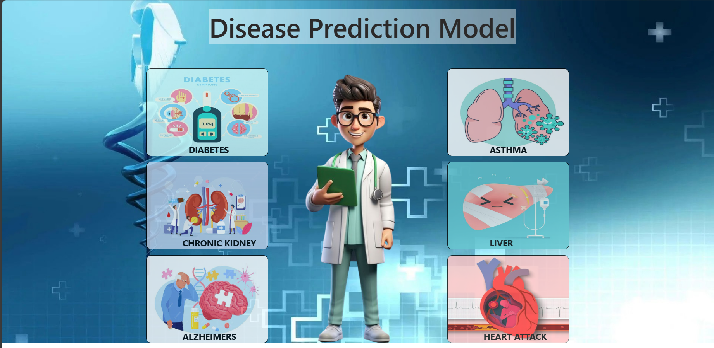
Output
Home Page

Slide 24
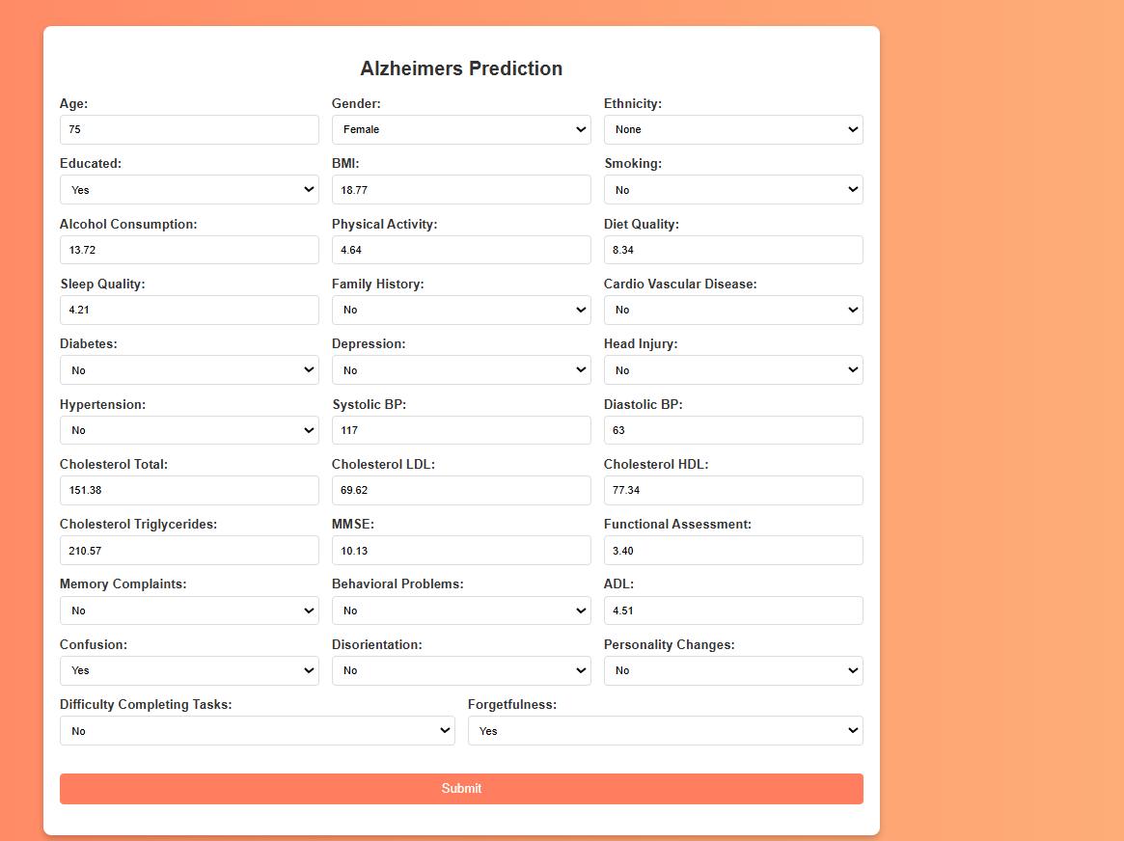
Result:
Patient has Alzheimer

Slide 25
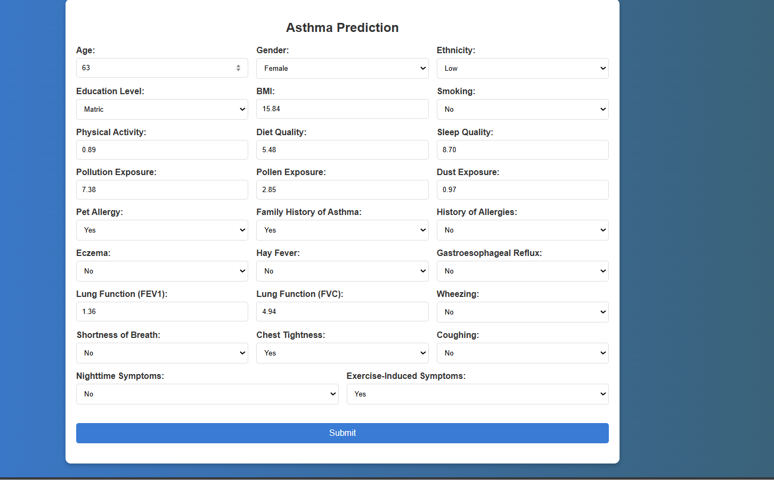
Result:
Patient don't have Asthma

Slide 26
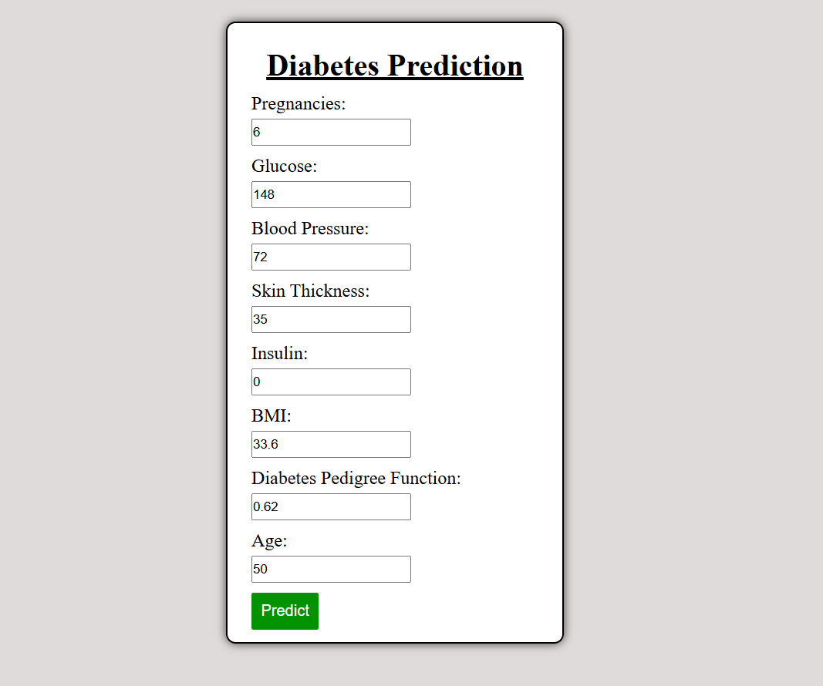
Result:
Patient is Diabetic

Slide 27
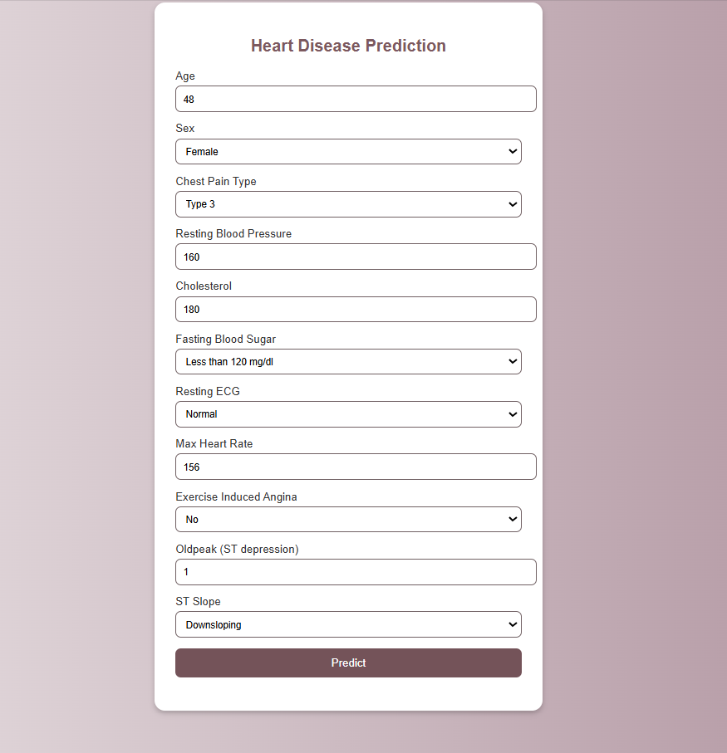
Result:
Patient is safe from heart attack

Slide 28
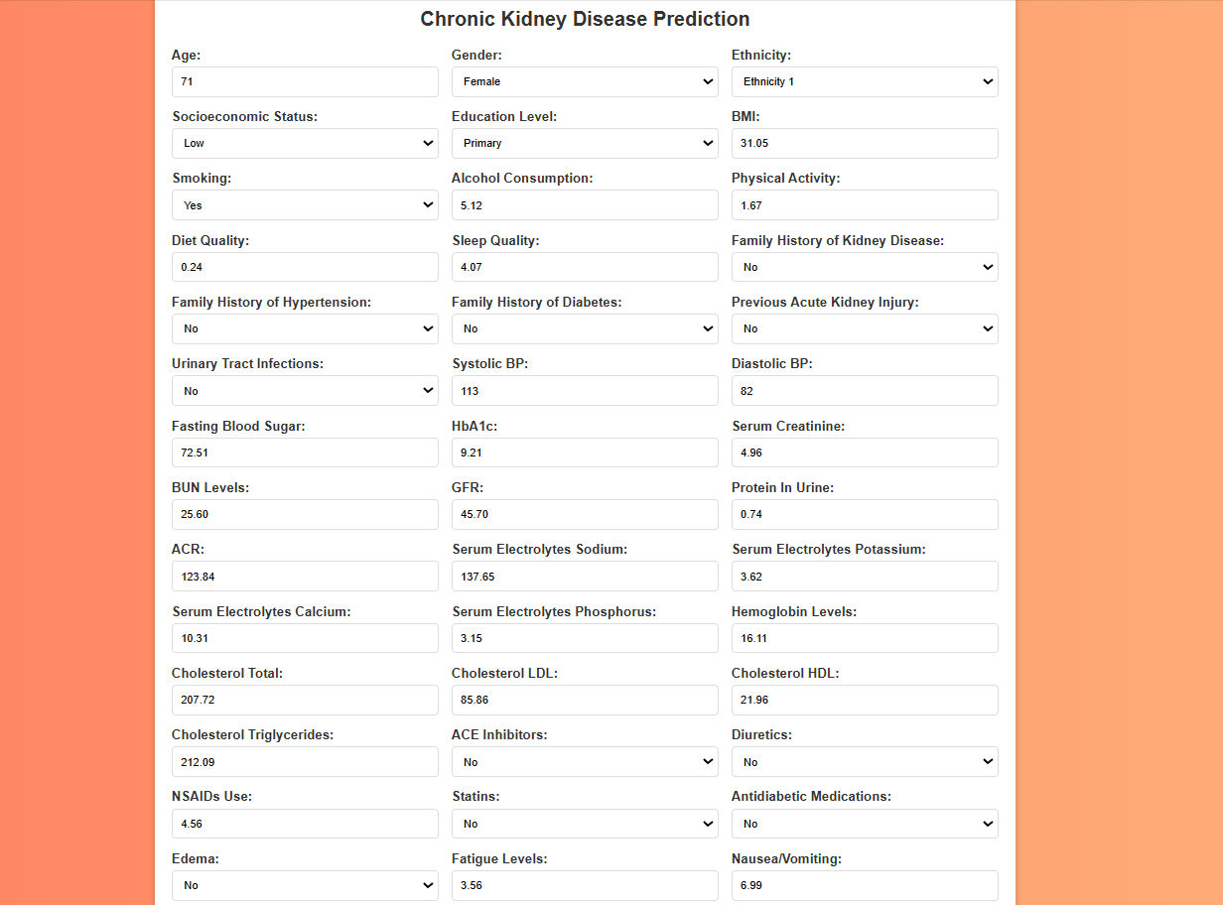
Result:
Patient has Chronic kidney

Slide 29
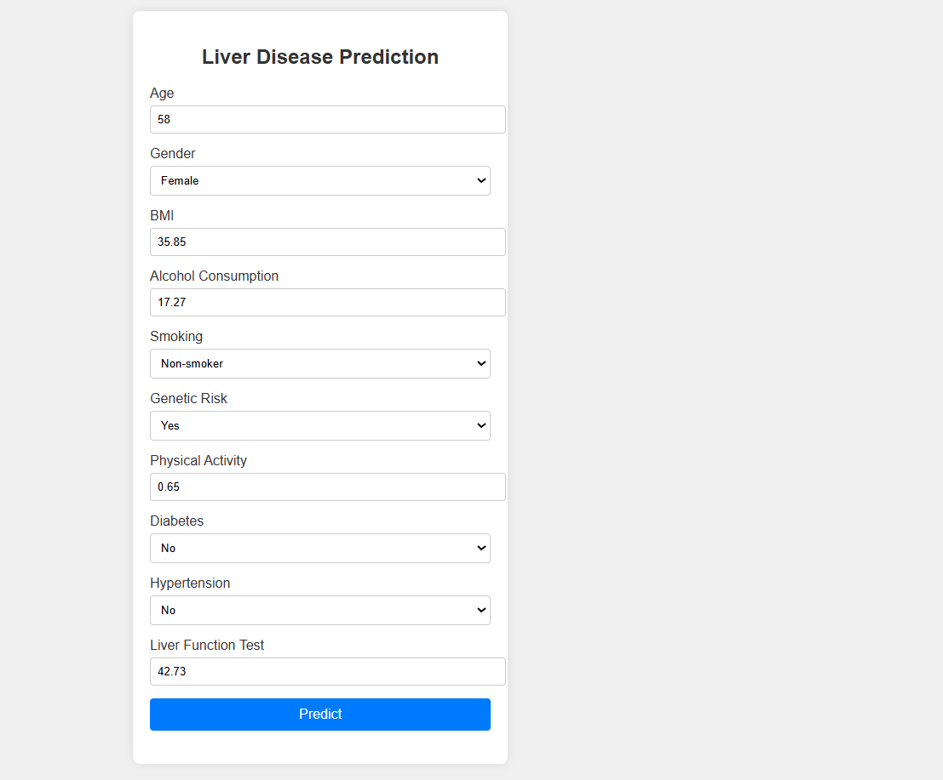
Result:
Patient has liver disease

Slide 30
Conclusion
Predicting multiple diseases using machine learning aligns with and supports the achievement of several UNSDGs by promoting early detection, improving health outcomes, reducing healthcare costs, and addressing health disparities. This approach fosters healthier communities, enhances economic stability, and contributes to overall societal well-being, thereby making significant strides towards the global goals of sustainable development.

Slide 31
References
Data Sources: The dataset used in this project is taken from Kaggle. There are several attributes in the data set on which we are predicting, analyzing, visualizing of Multiple Chronic Disease
Python: For data cleaning, analysis, and visualization, using libraries such as Pandas, NumPy, Scikit-learn, Matplotlib, and Seaborn.
VS Code: For documenting the analysis process and visualizations.
Scikit-learn: For developing predictive models and machine learning algorithms.

